Slide 1
Creating a sustainable open source ecosystem for mainframe through the Open Mainframe Project
John Mertic
Director, Open Mainframe Project

Slide 2
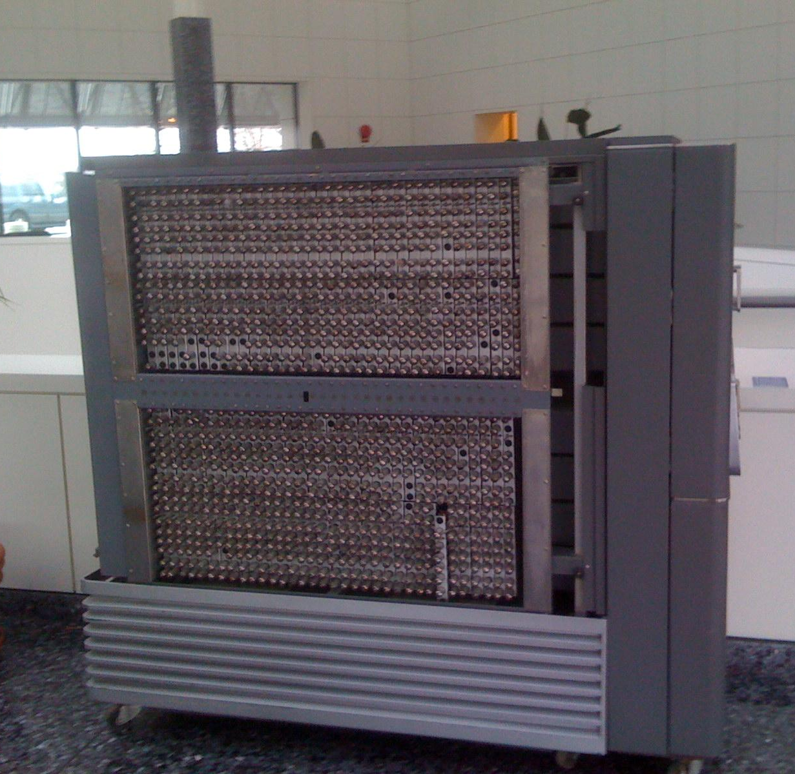
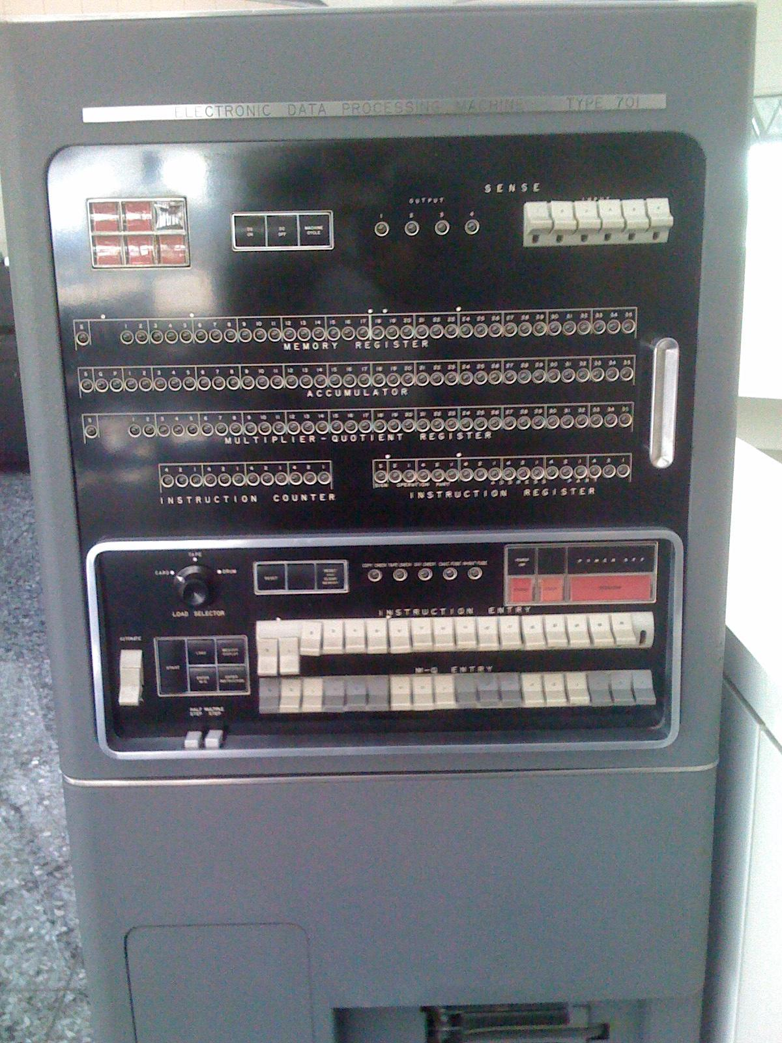
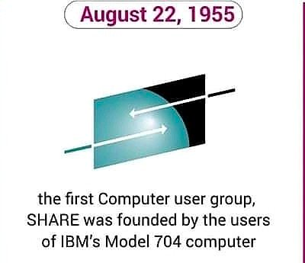
Notes:
Collaboration started in mainframe in 1955 with SHARE. You can trace the historical root of the open source movement back to SHARE in the 1950s, where mainframe operators got together to “share” source code ( though this sharing was more on physical media than how we would do today ).

Slide 3
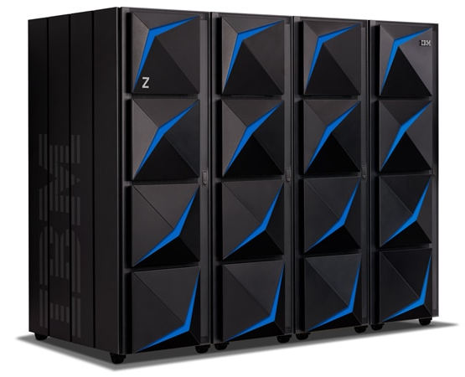
From the heritage of the model 704 to the modern mainframe ( IBM z15 )
Up to 190, 10 core 5.2ghz processors ( read more at https://en.wikipedia.org/wiki/IBM_z15_(microprocessor) )
Up to 40TB of RAIM (random array of independent memory)
Heavy optimization for i/o bound workloads
Hardware based encryption
Fault tolerant, native hot swapping of hardware components ( z stands for zero downtime )
And….runs Linux and Open Source!
Notes:
The modern mainframe has been designed along four guiding principles of security, availability, performance and scalability, that has carried on from the System/360 in the mid 1960’s through to the current z15 of today. If an organization needs security, availability, performance and scalability turned up to an 11, this is the only platform that can do that. And it is a great platform for Linux and Open source.

Slide 4
Early collaboration drives open source
1955
SHARE established Historical root of open source movement
1975
CBT Tape project founded One of the oldest open source projects.
1999
Linux ported to s390x by community effort from Marist University and other enthusiasts
2001
Major Linux Distros support mainframe Initially SUSE, but followed by Red Hat and others
2006
1,700 customers using Linux on s390x in production including SAP, DB2, and Oracle.
2013
Open Source ecosystem hits critical mass with OpenStack, KVM, PostgreSQL supported
Notes:
Linux came to the platform in late 1999, and Linux distribution vendor SUSE led the way in provide commerical support for the platform. Linux and open source grew significantly in the decade that followed.

Slide 5
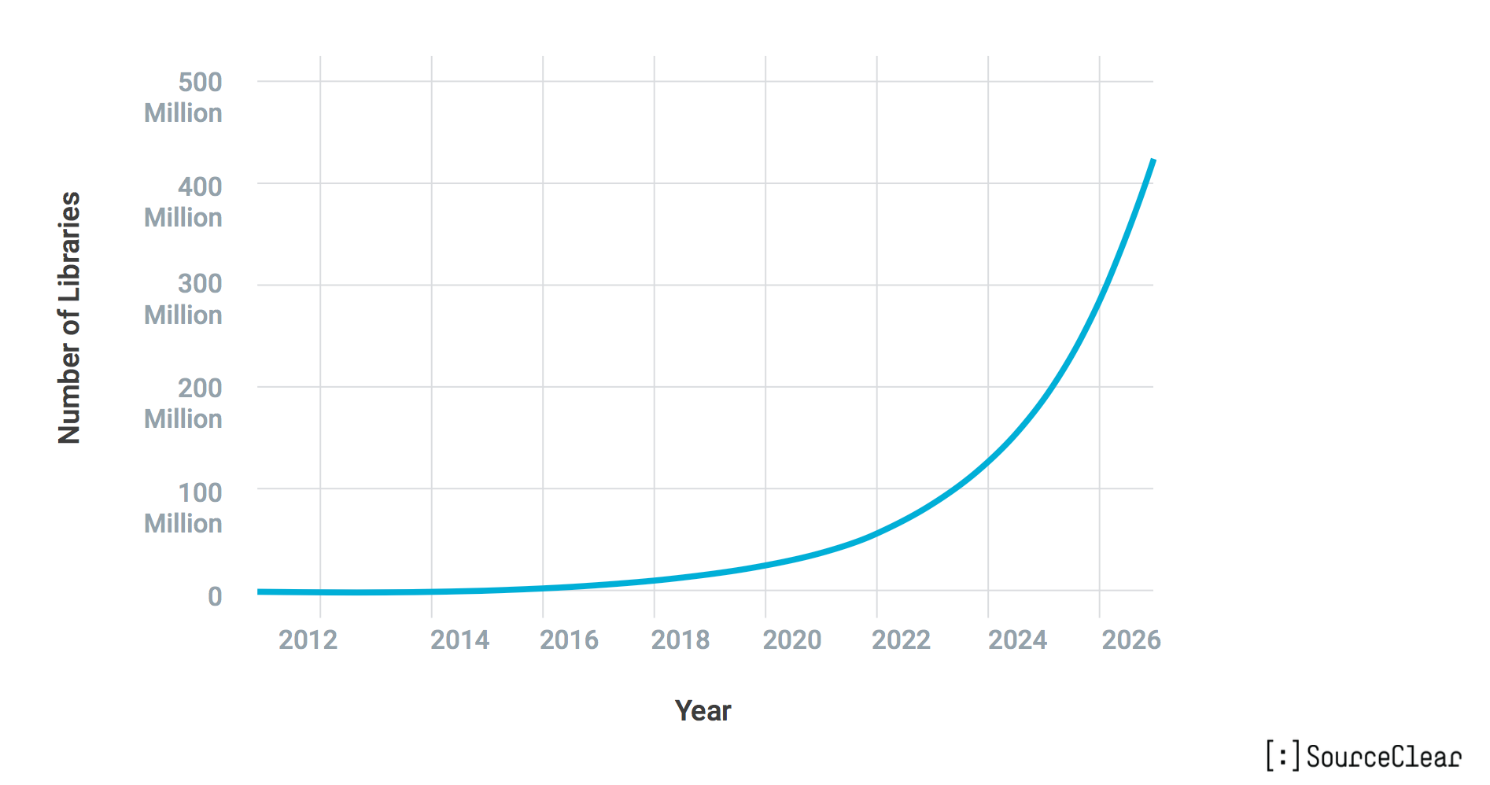
Open Source Isn’t Slowing Down Any Time Soon

Slide 6


Code Club (Sandwich)
Open Source Code = ~ 90%
Use Open Source Libraries to Solve Problems Open Source Code (~70%)
Write Custom Code Custom Code (~10%)
Choose a Framework Open Source Code (~20%)
Notes:
Open source is the sandwich the drives commercial applications, driving both the base infrastructure as well as the common needs of an application.

Slide 7
The Real Question is Which Projects Matter?
Value of of Individual Project
Number of Open Source Projects

Slide 8


Answer: Projects with sustainable ecosystems
PROJECTS
Successful projects depend on members, developers, standards and infrastructure to develop products that the market will adopt
DEVELOPER
COMMUNITY
TECHNOLOGY
PARTICIPATION
MARKETS
PRODUCTS
PROFITS
PRODUCTS

Slide 9
Sustainability is about longevity
sustainability (from sustain and ability) is the property of systems to remain diverse and productive indefinitely.

Slide 10
Open Source on Mainframe - Ecosystem Challenges
Glass ceiling for project investment and adoption
in the absence of a fair governance and safe haven for the project’s assets
1
Managing projects assets
As project grows, it is unclear who should own legal and administrative tasks that are essential to the health of the project
2
Developed for a specific product needs
The open source spinoff is a result of wanting to build an ecosystem and collaborate on building a platform
3
Governance challenges
No formal governance,
governance favors the creators of the project,
project backer dominating dev and governance
4
Fragmentation
Lack of integration
Lack of cross pollination across projects
5
Notes:
But what we’ve seen in other communities, communities often hit a “glass ceiling” on growth. This “glass ceiling” is caused by the lack of a vendor-neutral entity to ensure assets are managed, open and transparent governance exists, and the need for a diverse ecosystem to drive further investment.

Slide 11






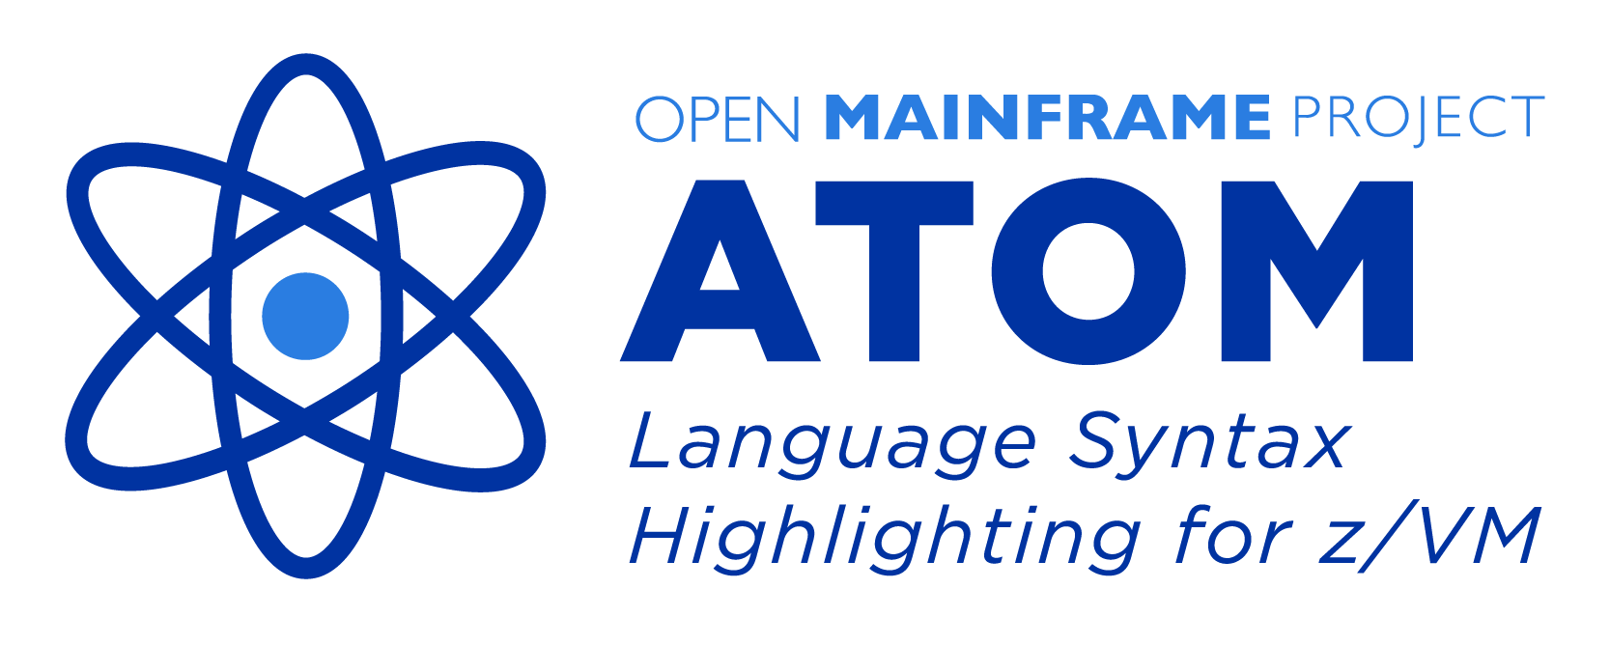


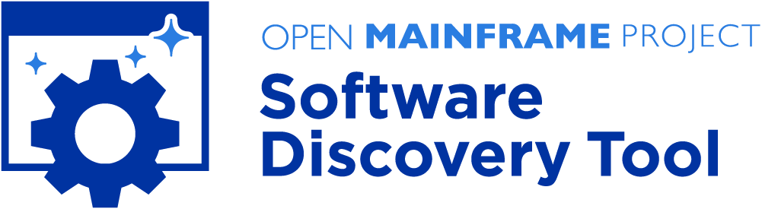



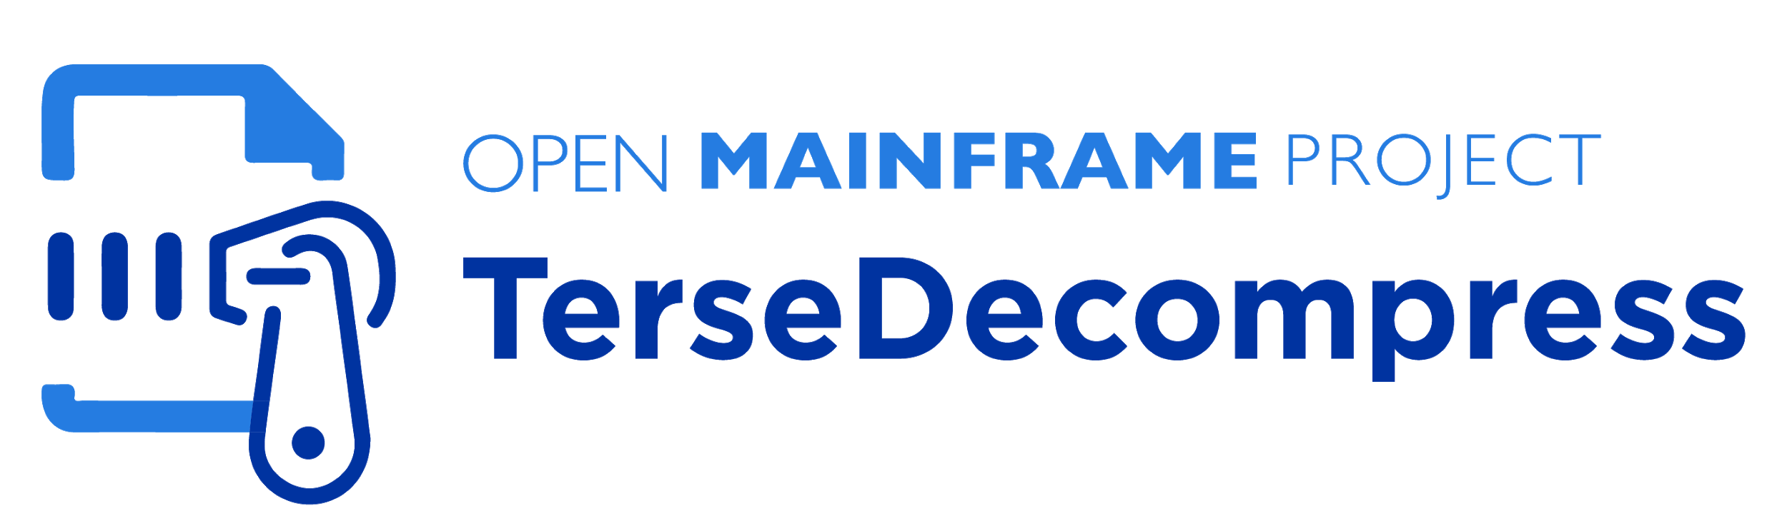
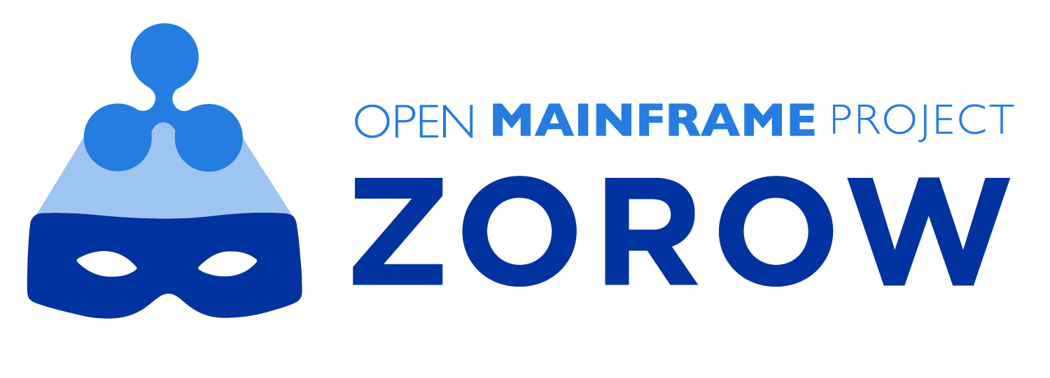

Innovation accelerates under Open Mainframe Project
2015
Open Mainframe Project launched at LinuxCon Seattle, along with LinuxONE and IBM contributions of seed code for ADE
2016
First summer interns port Alpine Linux, contribute to open source tooling.
2018
Zowe launched First ever open source project launched on z/OS
2019
Doubling of hosted projects with launch of 5 new projects
2020
Growth and maturity of ecosystem with new projects in COBOL, Education, open source discovery, and more
Notes:
The Open Mainframe Project was formed in 2015 to establish a vendor-neutral collaborative community, with many milestones along the way.

Slide 12
Mission of the Open Mainframe Project:
Build community and adoption of Open Source on the mainframe
Eliminating barriers to Open Source adoption on the mainframe
Demonstrating value of the mainframe on technical and business levels
Strengthening collaboration points and resources for the community to thrive

Slide 13
Eliminating barriers to Open Source adoption on the mainframe
Engaged as central expert in demonstrating the mainframe as a viable open source platform, with compelling advantage.
Promotion of modern application and workload examples on the mainframe
Growing career opportunities and academic community engagement
Hosting and participating in local programming and promotion of Open Source on the mainframe
Sponsorship of global initiatives and contests to grow enthusiasm for the platform

Slide 14
Demonstrating value of the mainframe on technical and business levels
Showcase of technical and business case studies through blogs, white papers, and other media.
Champion software and hardware solutions with clients

Slide 15
Strengthening collaboration points and resources for the community to thrive
Engagement through hosted projects and independent projects by members
Visibility to tools, resources, and community forums to tackle technical challenges
Career opportunities from internships through retirement

Slide 16
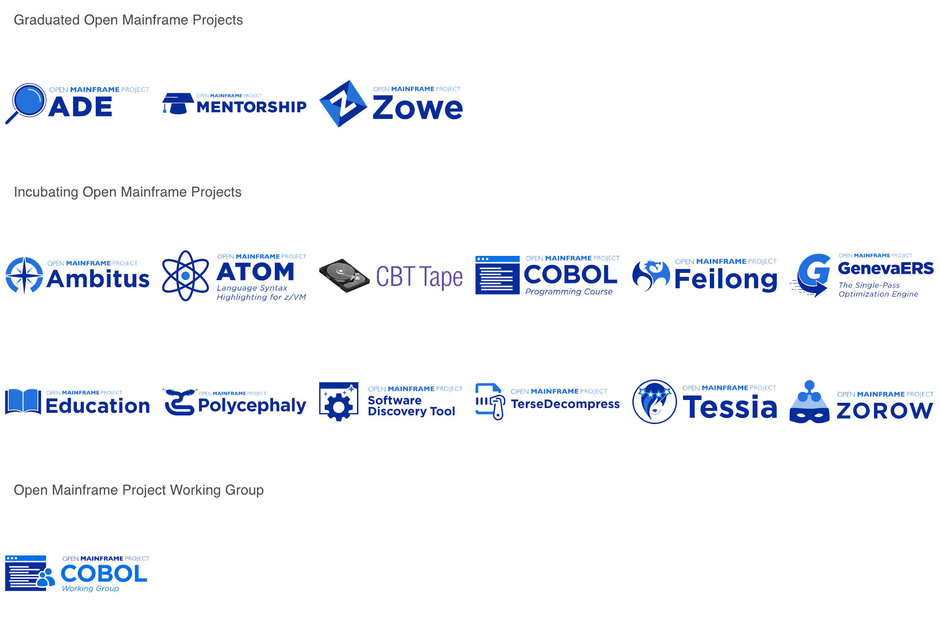
Creating spaces for mainframe community open source collaboration
Learn about all Open Mainframe projects at https://www.openmainframeproject.org/projects
Notes:
Source: https://landscape.openmainframeproject.org/format=borderless-mode&project=hosted&embed=yes

Slide 17
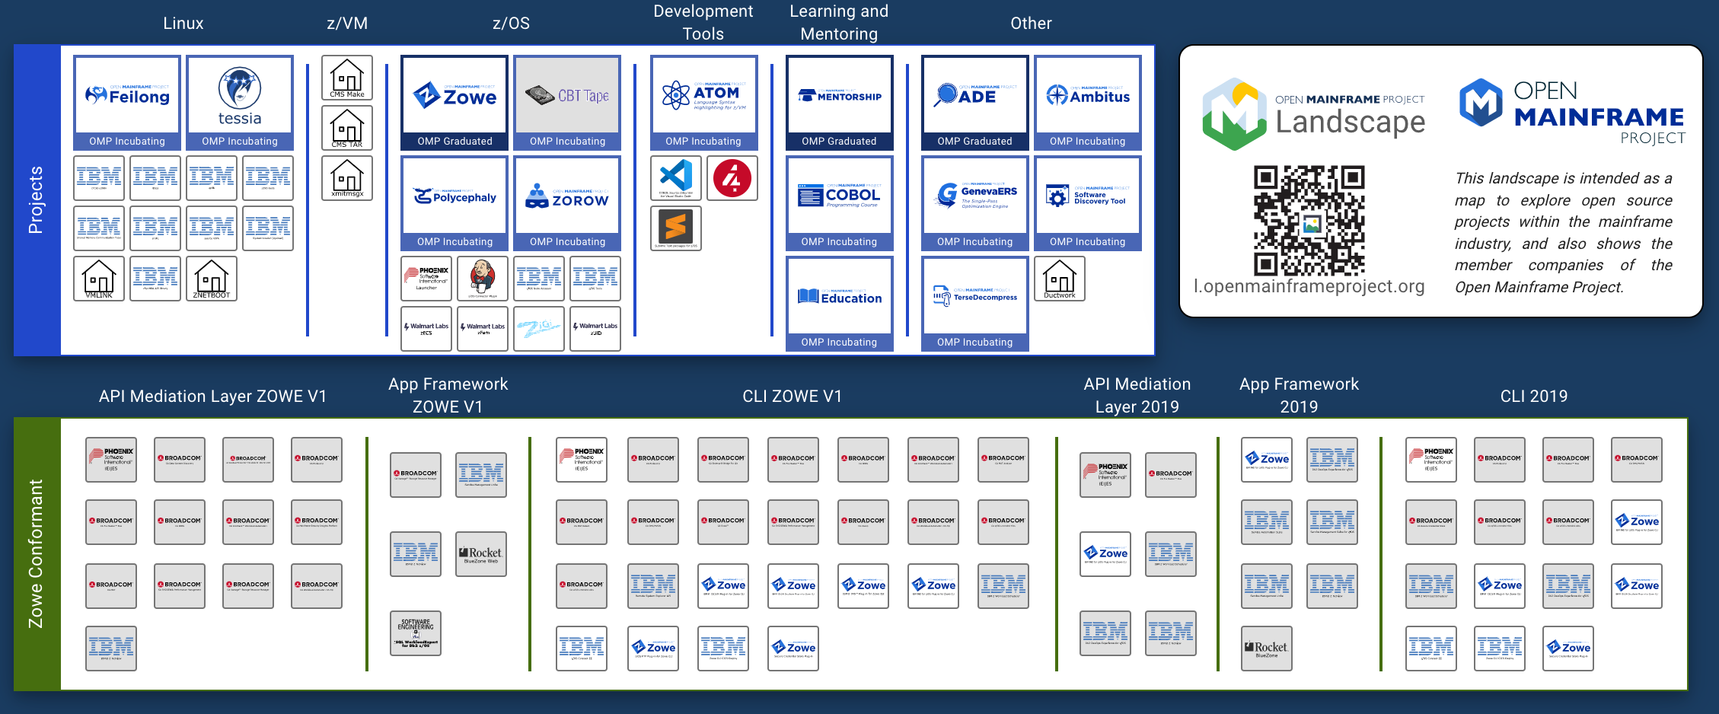
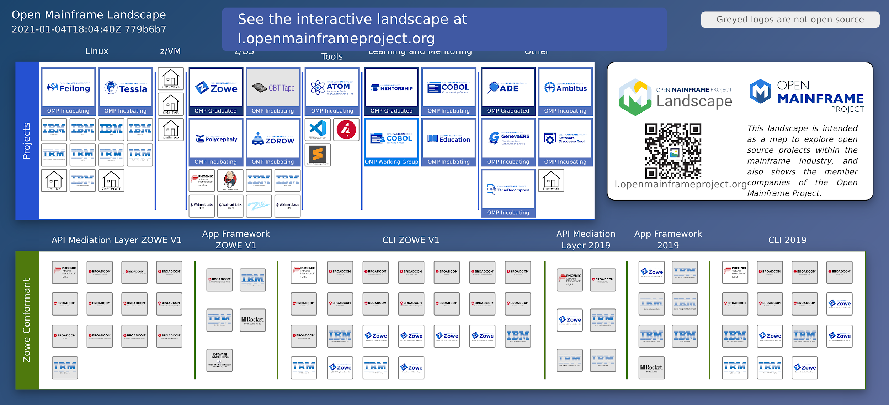

Slide 18
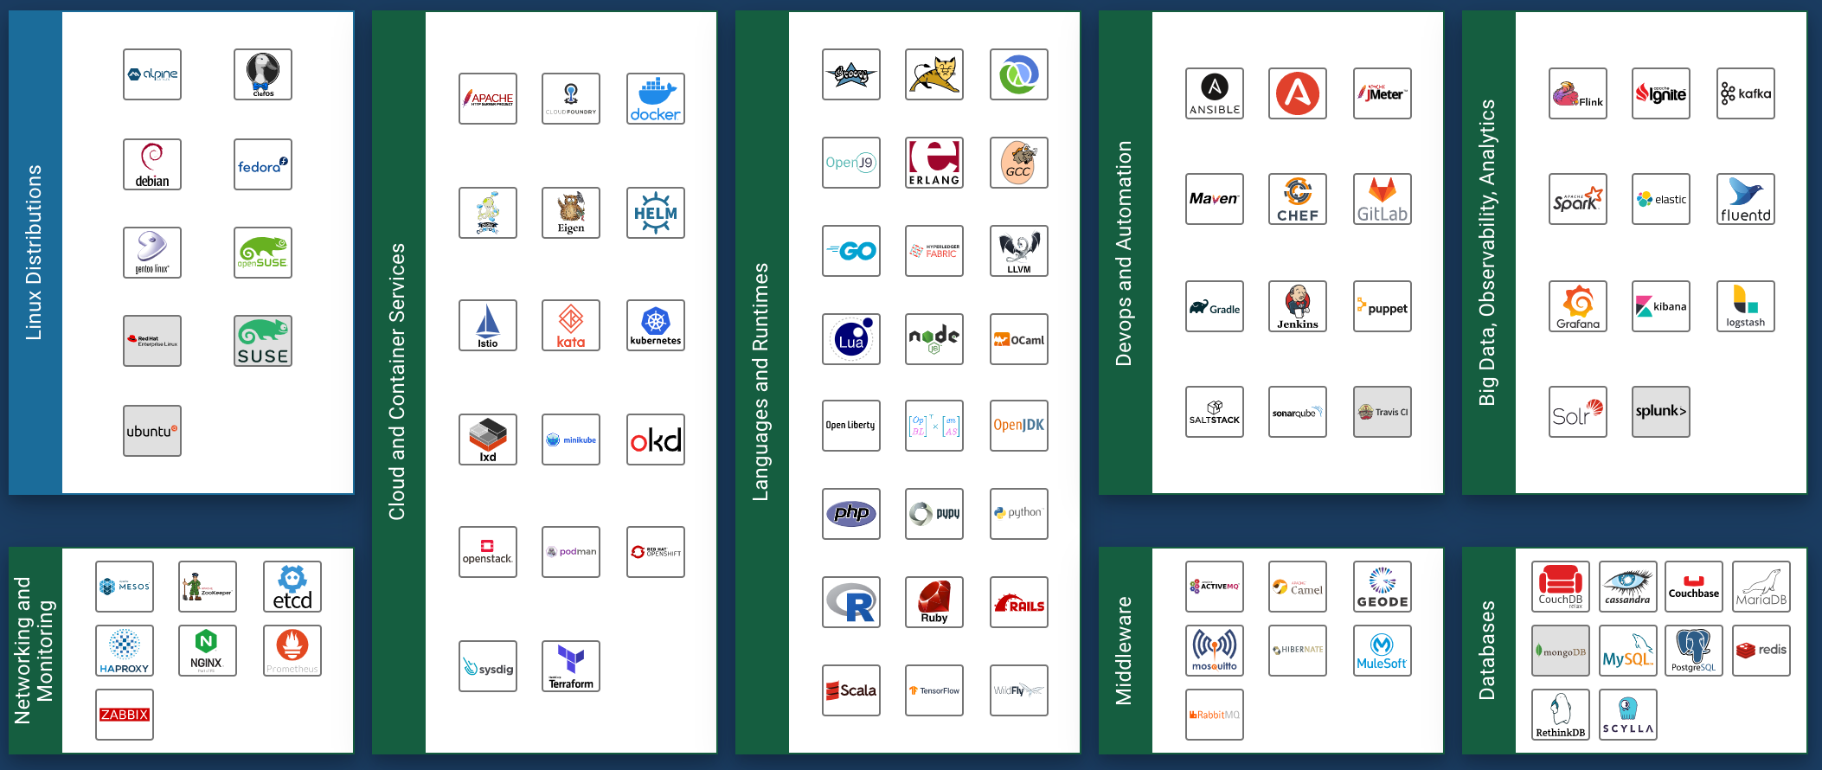
Supported Broad Open Source projects on mainframe
Notes:
Source: https://landscape.openmainframeproject.org/format=open-source

Slide 19

Connecting z/OS to enterprise devops with Zowe
Major Problem
How OMP Innovated
Results - 2020
Modernize integration with z/OS based applications and services
Bridge the talent gap by enabling modern development stacks on z/OS
2018 Open Mainframe Project added Zowe
2019 Zowe reached 1.0, launched Zowe Conformant to enable downstream ecosystem
Investments in collaboration, ecosystem development, and infrastructure
20000+ Commits, 200+ committers all time
Zowe gaining significant mindshare in DevOps community
20+ Zowe Conformant offerings

Slide 20

Modernize z/VM integration with cloud technologies
Major Problem
How OMP Innovated
Results - 2020
Users want to manage their mainframes with the same modern cloud technologies used across the enterprise.
z/VM integration with technologies such as OpenStack have long been a challenge.
Contribution base was IBM only, making it challenging to get wider adoption
2019 Open Mainframe Project added Feilong
Feilong TSC elects co-chairs from SUSE and Velocity Software
Building open CI/CD infrastructure and development environment
SUSE, Velocity Software, Vicom Infinity, and ICU IT engaging in addition to IBM
New innovations and integrations being created in the community to upstream.
Hub of innovation and collaboration within the project community.

Slide 21

Bringing together the COBOL community
Major Problem
How OMP Innovated
Results - 2020
COBOL talent is critical to our society, and the need has amplified in the COVID-19 pandemic.
Enabling the next generation to have COBOL skills done in isolation, causing repeated efforts and lower uptick.
Launched COBOL Programming Course as an open source project in April 2020
Created collaboration forums and ways that COBOL talent can advertise their availability
“Calling all COBOL Programmers” forum has had over 1700 individuals make themselves available in less than 3 months
COBOL Programming Course has 1.7k stars and 300+ forks in less than 3 months, along with 17 contributors from several organizations.

Slide 22
Bringing next generation through open source
Major Problem
How OMP Innovated
Results - 2020
Aging tenured mainframe talent, with a growing mainframe talent gap and skills decline in next generation talent.
Needing to help connect students with opportunities in mainframe, aligning the interests in open source
Launched first mentorship program in 2016 with 7 mentees.
Connected within the mainframe and broad open source community to ensure mentorship work has upstream project value.
Enabled universities to also leverage the program within class work; successful with VCU and Western University (Ontario)
40+ mentees completed the program, with broader classwork focus reaching 100+ more.
Upstream work has included ports of Alpine Linux, contributions to HyperLedger, OpenStack, CloudFoundry, Kubernetes, and more.
Several mentees are now employed in mainframe roles with IBM, SUSE, ADP, and more.

Slide 23
Open Mainframe innovation thrives here
OMP provides a vendor-neutral home for mainframe-centric open source projects
Code hosting/infrastructure
Governance
Legal/Trademark defense
Ecosystem development
LF staff support project communities establishing guidelines and best practices to enable diverse community growth and adoption
Our philosophy creates natural collaboration opportunities between mainframe-centric open source projects
Project lifecycle, guidance, and proposal process openly defined at https://www.openmainframeproject.org/projects/lifecycle

Slide 24
Supporting open source on mainframe beyond hosted projects

Slide 25




Sustained mainframe support in the broad open source community through the Supported Projects program
Infrastructure | Developer support | Market awareness | Governance/IP Home
Participating Open Source Projects include

Slide 26
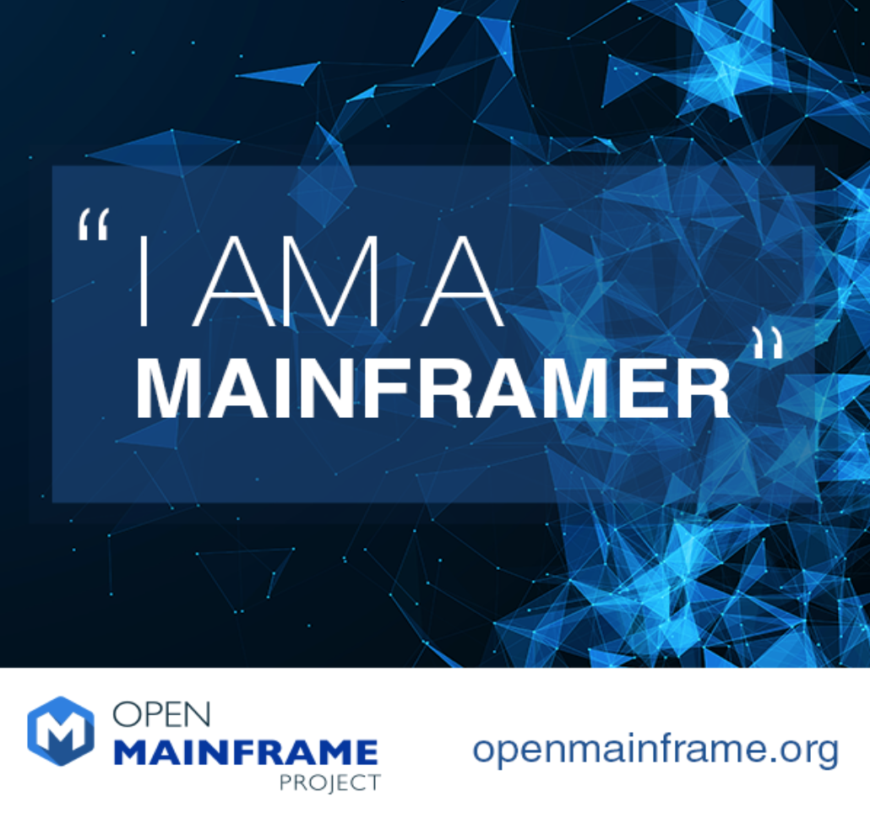



Telling the “mainframer” story
Monthly interview series that highlights diversity in mainframe
Showcases why people have mainframe in their careers and their views of the technology and career field
Read and listen at https://www.openmainframeproject.org/news/podcast

Slide 27
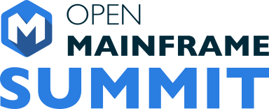
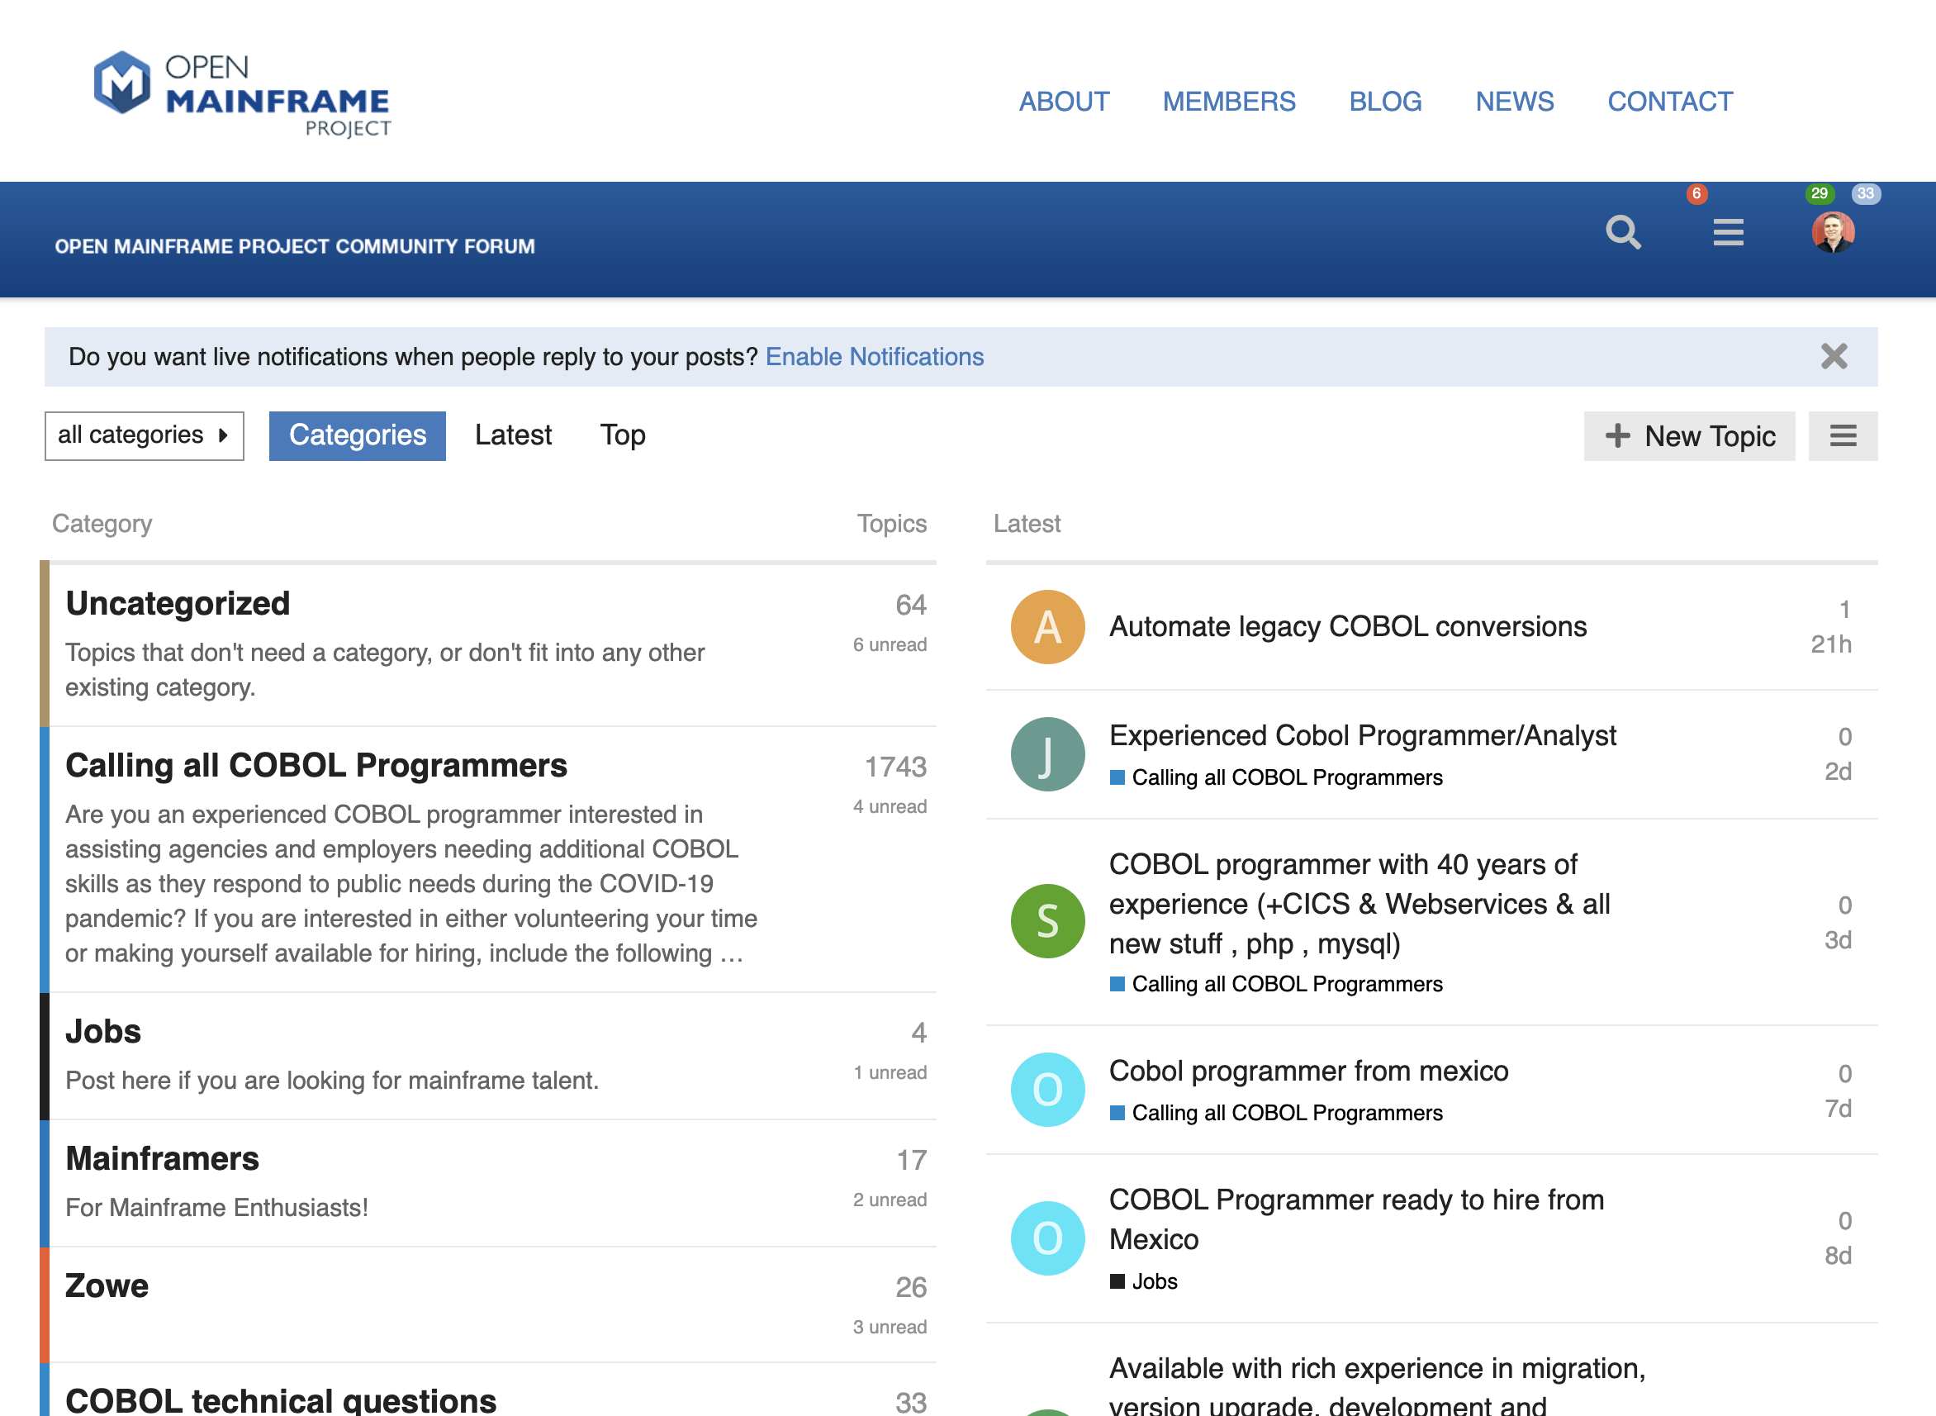

Bringing together the open source and mainframe conversation
Annual Open Mainframe Summit
https://events.linuxfoundation.org/open-mainframe-summit
Community Forums
https://community.openmainframeproject.org/
Slack Channel
https://slack.openmainframeproject.org

Slide 28
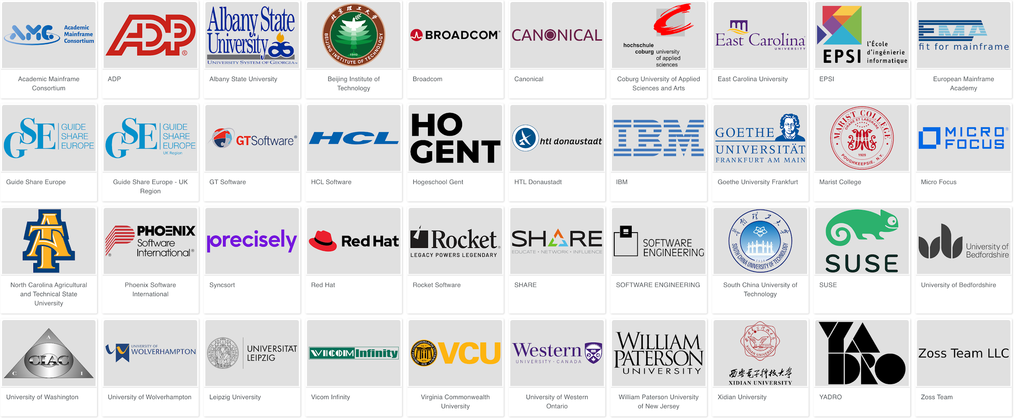
5 years since launch | 40 Supporting Organizations | 16 Hosted Projects and Working Groups | 40+ Mentees Sponsored | 300+ Project Contributors | 30,000+ Project Contributions
Notes:
Source: https://landscape.openmainframeproject.org/category=open-mainframe-project-member-company&format=logo-mode&grouping=no&embed=yes

Slide 29




How to participate in Open Mainframe Project
Open participation for all interested in Mainframe and Open Source
Community discussion and collaboration - both virtually and at regional events.
16 Shared R&D open source projects and working groups - or bring your project to be hosted here
Corporate sponsorship for showing stewardship in the community
‹#›
Notes:
Anyone may participate; the Open Mainframe Project will encourage companies to become sponsoring participants and support the mission of the Open Mainframe Project with resources
Corporate participation levels include Platinum, Platinum End-User, Silver, Academic and Associate Entity levels.
A Technical Steering Committee will focus on overseeing the technical community
Approves new Open Mainframe Project projects, sets development process guidelines for the community, sets release guidelines, oversees technical collaboration with upstream projects, etc.
The initial TSC will be bootstrapped with representatives from the Platinum and Platinum End-User level participants with the goal of adding projects with Maintainers to the TSC.
Anyone can contribute, become a project committer or maintainer and thereby serve on the TSC based on the success and quality of their contributions as recognized by peers.
A Governing Board will oversee business decision making
Composed of Platinum-level participant appointees, elected Silver representatives, elected Academic Institution representatives, and the TSC Chair.
The Governing Board will address the business needs associated with budgeting, planning for any large meetings (e.g. a Summit), marketing (if any), whether to run a “summer of code” internship, etc.

Slide 30


Learn more about the Open Mainframe Project
Find out more and subscribe to our newsletter at www.openmainframeproject.org
Discover and participate in any of our 16 hosted projects and working groups at https://www.openmainframeproject.org/projects
Organizational membership opportunities at https://www.openmainframeproject.org/about/join or email at membership@openmainframeproject.com
If you are ready to pursue corporate members, complete the paperwork at https://joinnow.openmainframeproject.org

Slide 31
Thank you!

Slide 32
Membership

Slide 33
Membership Benefits (1)
Industry Leadership
Shape the Open Source Mainframe market
Network with other members of Open Mainframe Project
Participate in Open Mainframe Project event and speaking opportunities
Join Open Mainframe Project Projects
Serve on the the Governing Board to help shape investments of Linux and Open Source on Mainframe (Platinum only)
Marketing Opportunities
Benefit from and participate in Open Mainframe Project marketing efforts
Engage with your peers on the marketing committee
Feature your products and applications that leverage Linux and Open Source on Mainframe at key industry events, website and marketing collateral
Use Open Mainframe Project branding assets in promotion of your product
Discounted sponsorship opportunities for Open Mainframe Project

Slide 34
Membership Benefits (2)
Technology Leadership
Contribute to and influence the direction of Open Mainframe Project technical investments
Drive leadership for future enhancements and extensions that matter for your business
Ability to guide feature sets in requirements documents and future technology roadmaps
Support and drive community work by being a voting member of the Technical Steering Committee (Platinum only)
Learning and Engaging
Engage and collaborate with the membership community to enhance your Open Source/Linux on Mainframe roadmap.
Work together across company lines and industries.
Create products & apps secure in the knowledge that they will be interoperable in across enterprise class architectures.
Ability to serve as an Open Mainframe Project Advocate at events and in the community.

Slide 35
Additional benefits from Linux Foundation membership
The Linux Foundation members' benefits aren't just a list of "this is what you get as a member" -- rather the range of benefits vary in value and relevance based on the company. Some highlights include…
Let us know how we can help connect you to these opportunities!
An invite to our member-exclusive Linux Foundation Member Summit, fosters collaboration, innovation, and partnerships among the leading projects and organizations working to drive digital transformation with open source technologies.
Ability for your legal counsel to participate in bi-monthly legal calls and the annual Linux Foundation Legal Summit, helping connecting them to their peers and advancing your organization’s open source licensing, litigation, compliance, and best practices.
Introductions to other Linux Foundation members and hosted projects that are of interest to you to expand business opportunities.
Employees at your organization are eligible for a 20% discount to Linux Foundation events (use code LFMEM20 when registering).
Receive a discount of 5-7% for sponsoring Linux Foundation Events. Sponsorships offer a valuable way to reach the community of Open Source Developers, Engineers, C-level Executives and more.

Slide 36
Corporate, Academic, Associate Membership Levels
Level | Annual Fee | Board Seat | TSC Seat | Marketing Committee | Notes
Platinum | $120,000 | Yes | Voting | Yes | Initial 2-year participant commitment
Platinum End-User | $30,000 | Yes | Voting | Yes | Initial 2-year participant commitment
Silver | 3,000 employees or more = $30,000 1,000 < 3,000 employees = $25,000 500 < 1,000 employees = $20,000 100 < 500 employees = $12,000 < 100 employees = $7,000 | 1 per 10 | Non Voting | Yes
Academic | Free | 1 per 10 | Non Voting | Yes | Restricted to academic institutions
Associate | Free | No | Non Voting | Yes | Non-profits, open source projects
To join Open Mainframe Project, go to https://www.openmainframeproject.org/about/join or email at membership@openmainframeproject.com
Listed fees include Linux Foundation Silver membership. If you are already a Linux Foundation Member, reduced pricing is available.
‹#›

